Slide 1

Bank Dataset
Aaron Abromowitz, Stephanie Duarte, Dammy Owolabi

Slide 2
Agenda
Introduction
EDA
Objective 1: Interpretative Model
Objective 2: Predictive Models
Conclusion

Slide 3
Introduction
Bank dataset from portuguese bank
41,188 clients, 19 explanatory variables, 1 variable of interest
9 numeric variables, 10 categorical variables
Categorical variables had “unknown” values as a separate class
Variable of interest: has the client subscribed to a term deposit?
This is the ‘y’ variable in the dataset
Bank is interested in the effectiveness of their campaign
Random 80/20 split
Training Data: 32,950 rows, used for analysis and model creation
Test Data: 8,238, used for model validation

Slide 4
Note on Duration Variable
Duration = last contact duration, in seconds (numeric)
This attribute highly affects the output target (e.g., if duration=0 then y="no").
This input should only be included for benchmark purposes and should be discarded if the intention is to have a realistic predictive model.
We decided to remove the variable from our analysis

Slide 5
EDA

Slide 6
Dataset Columns (subset)
Variable Name | Variable Description | Variable Category | Data Class
default | Has credit in default? | bank client data | categorical
loan | Has personal loan? | bank client data | categorical
month | last contact month of year | related with the last contact of the current campaign | categorical
day_of_week | last contact day of the week | related with the last contact of the current campaign | categorical
campaign | number of contacts performed during this campaign and for this client | other attributes for the campaign or past campaigns | numeric
pdays | number of days that passed by after the client was last contacted from a previous campaign, 999 means client was not previously contacted | other attributes for the campaign or past campaigns | numeric
previous | number of contacts performed before this campaign and for this client | other attributes for the campaign or past campaigns | numeric
emp.var.rate | employment variation rate - quarterly indicator | social and economic context attributes | numeric
euribor3m | euribor 3 month rate - daily indicator | social and economic context attributes | numeric
nr.employed | number of employees - quarterly indicator | social and economic context attributes | numeric

Slide 7
Summary Statistics - Numeric
Variable Name | Min | 1st Quartile | Median | Mean | 3rd Quartile | Max
age | 17 | 32 | 38 | 40.1 | 47 | 98
campaign | 1 | 1 | 2 | 2.6 | 3 | 56
pdays | 0 | 999 | 999 | 963 | 999 | 999
previous | 0 | 0 | 0 | 0.2 | 0 | 7
emp.var.rate | -3.4 | -1.8 | 1.1 | 0.075 | 1.4 | 1.4
cons.price.idx | 92.20 | 93.08 | 93.75 | 93.57 | 93.99 | 94.77
cons.conf.idx | -50.8 | -42.7 | -41.8 | -40.5 | -36.4 | -26.9
euribor3m | 0.63 | 1.34 | 4.86 | 3.61 | 4.96 | 5.05
nr.employed | 4,964 | 5,099 | 5,191 | 5,167 | 5,228 | 5,228

Slide 8
Summary Statistics - Categorical
Variable Name | Num Categories | Min Size | Median Size | Max Size
job | 12 | 257 (unknown) | 1,290 | 8,283 (admin)
marital | 4 | 66 (unknown) | 6,474 | 19,937 (married)
education | 8 | 16 (illiterate) | 3,758 | 9,738 (university.degree)
default | 3 | 2 (yes) | 6,888 | 26,060 (no)
housing | 3 | 794 (unknown) | 14,918 | 17,238 (yes)
loan | 3 | 794 (unknown) | 4,959 | 27,197 (no)
contact | 2 | 11,961 (telephone) | 16,475 | 20,989 (cellular)
month | 10 | 138 (dec) | 2,702 | 11,023 (may)
day_of_week | 5 | 6,285 (fri) | 6,513 (tue) | 6,874 (thu)
poutcome | 3 | 1,087 (success) | 3,438 | 28,425 (nonexistent)

Slide 9
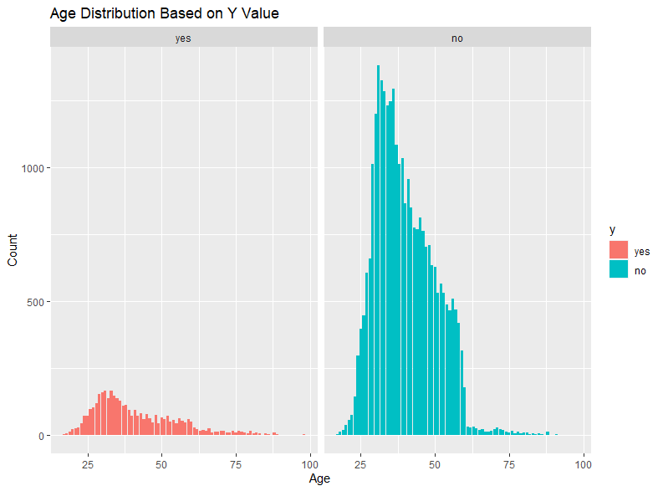
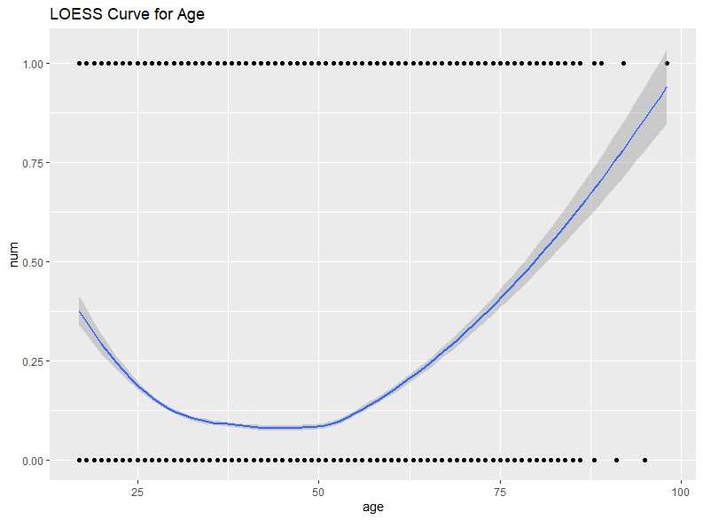
Ages
Bank client data
Numeric
Similar distribution overall for both yes and no
Far more no values than yes values
People with age over 60 seem to be more likely to have a term deposit
Probability of yes decreases, then increases
Overall, it seems that this will not be a good variable for prediction

Slide 10
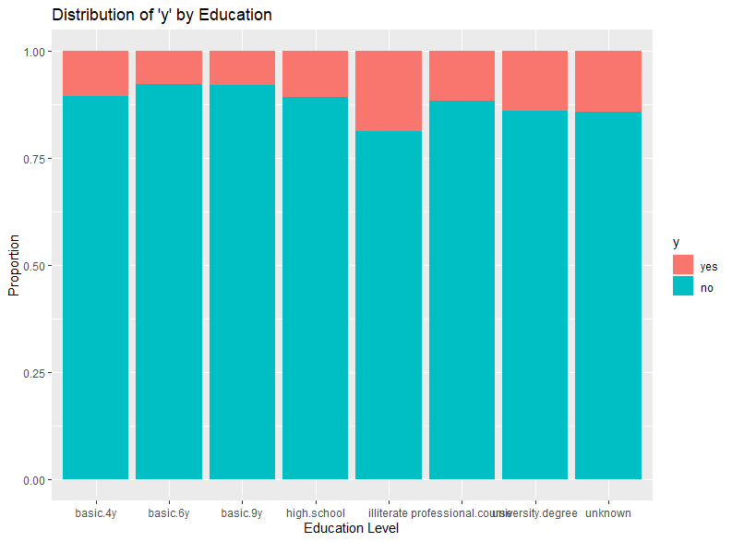
Education Data
Bank client data
Categorical
Similar proportion of yes and no across all Education Levels
This variable does not seem like it will be useful for prediction either

Slide 11
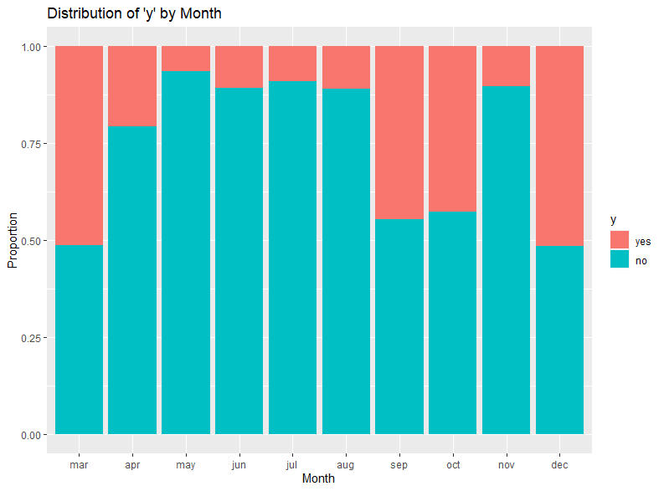
Month Data
Related with the last contact of the current campaign
Last contact month
Categorical
Some months have far more Yes values than other months
Knowing the month could be useful for prediction

Slide 12
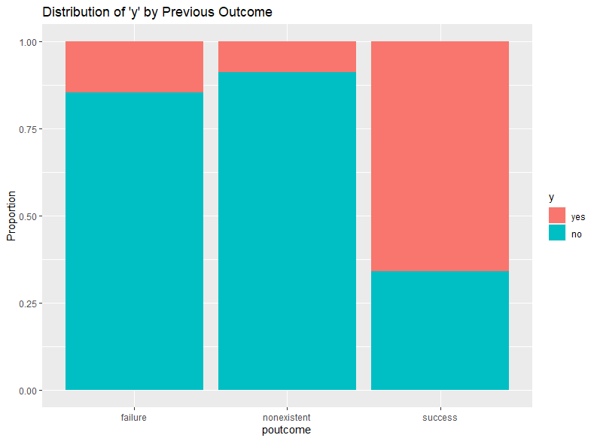
Previous Outcome Data
Result of previous campaign
Categorical
If this person previously signed up for a Term Deposit, it is far more likely they will sign up again

Slide 13
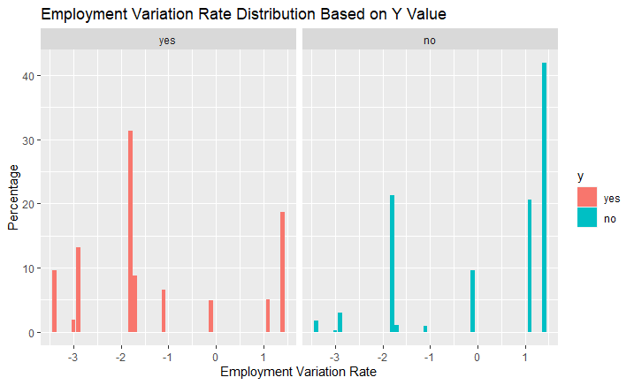
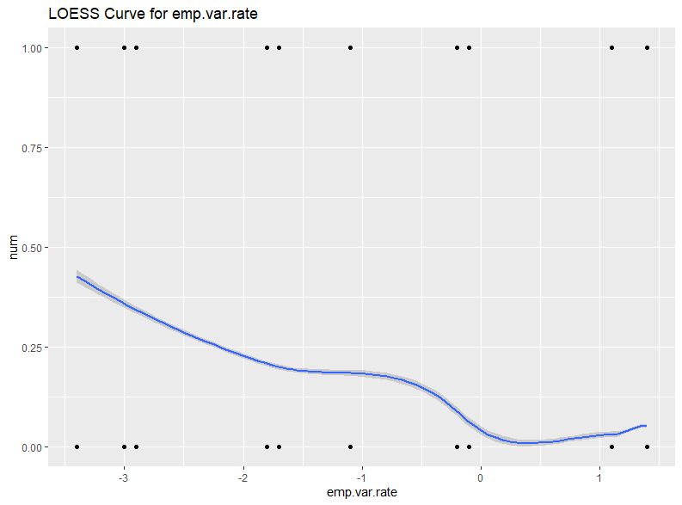
Employment Variation Rate
Socio Economic Data
Numeric
Quarterly Indicator
When this value is higher, less people have a term deposit

Slide 14
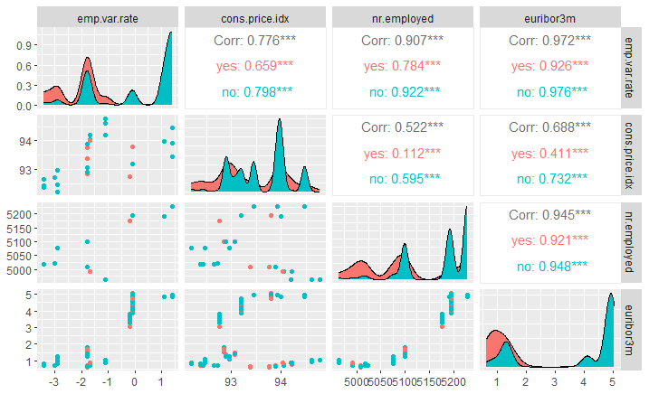
Socio-Economic Correlations
Employment Variation Rate, Number Employed, and Euribor 3 month rate are all highly correlated

Slide 15
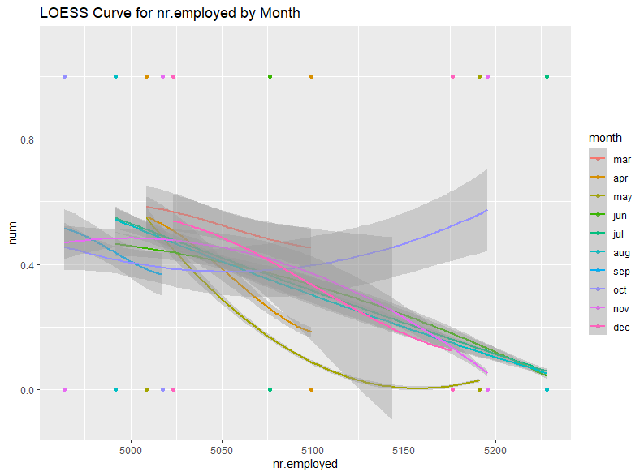
Number Employed by Month
Nr.employed is highly correlated with emp.var.rate, so an increase will cause a decrease in Yes
This seems to vary by Month though, where some months don’t have very high nr.employed values at all
This points to both these variables being useful in the model
Possible variable interaction

Slide 16
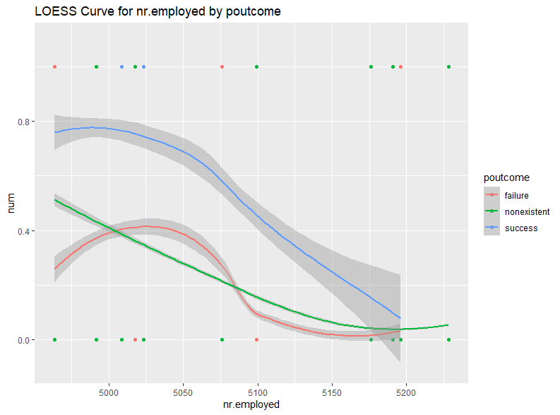
Number Employed by Poutcome
All poutcome results show the same behavior, an increase in nr.employed leads to a decrease in Yes probability
This decrease has the same rate roughly, but different starting points
Points to both variables being useful in a model, but maybe no interaction

Slide 17
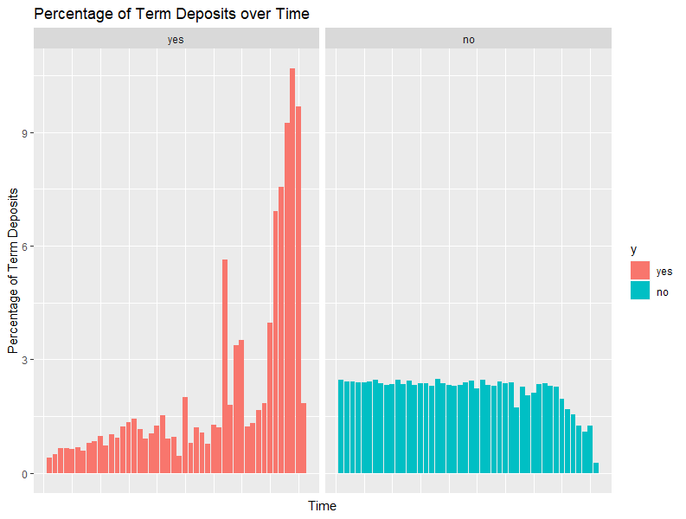
Data over time
The data rows were in order that they were received
We wanted to see if the distribution of data changed over time
For Term Deposits, those became more common as time went on
Wanted test data to have similar characters to training data, so used random 80/20 split

Slide 18
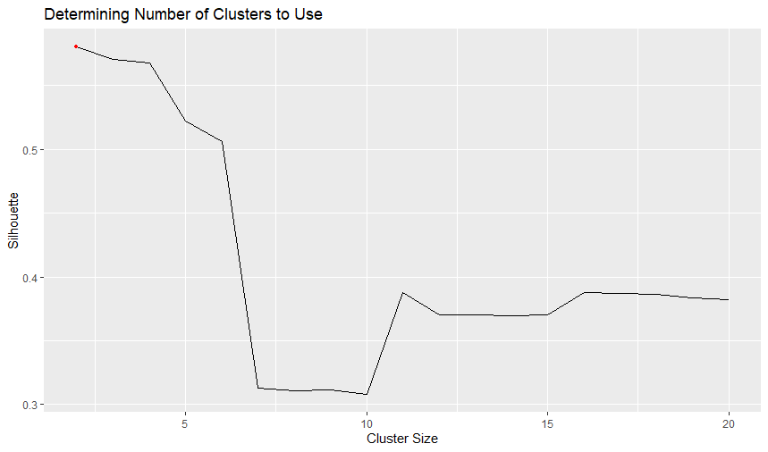
Clustering
Attempted to cluster numeric variables
Used Silhouette Statistic as metric for scoring clusters
2 clusters scored the highest, but there was an increase from 10 to 11 clusters
Proceeded to investigate cluster sizes of 2 and 11

Slide 19
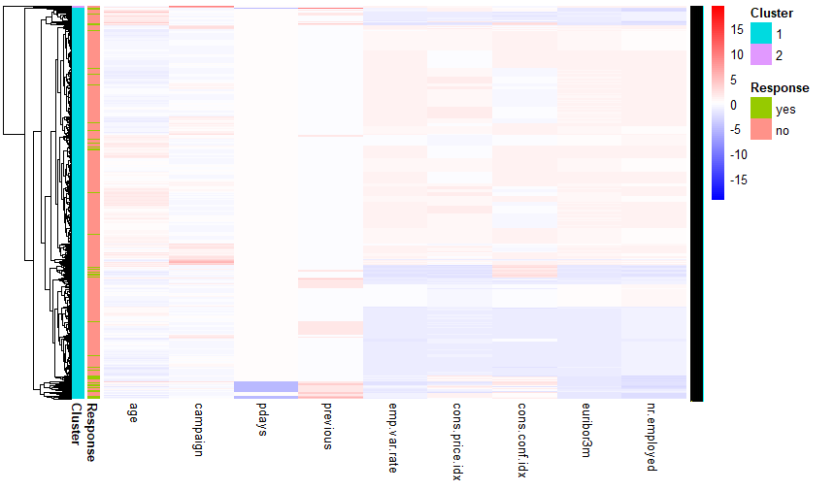
Heatmap - 2 Clusters
Cluster is too small to be very useful

Slide 20
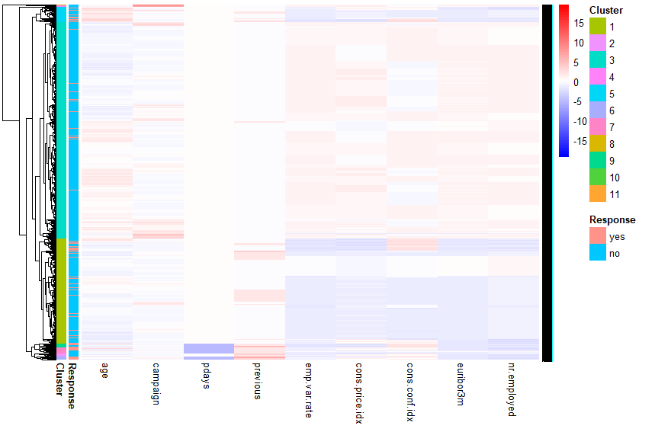
Heatmap - 11 Clusters
11 Clusters is more interesting
Some clusters contain many ‘yes’ responses
Many clusters seem to have a similar number of ‘yes’ to ‘no’ as the dataset as a whole does

Slide 21
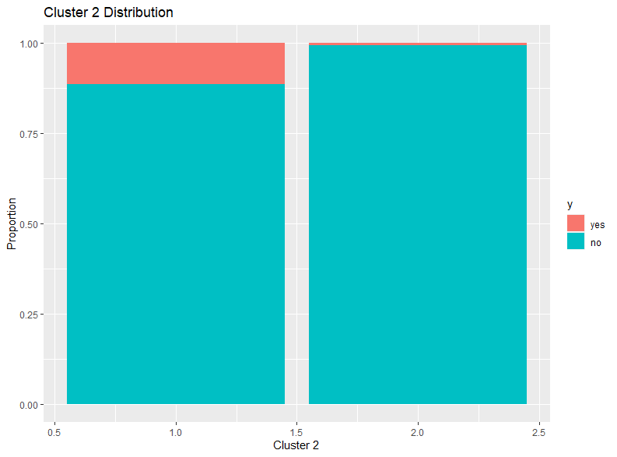
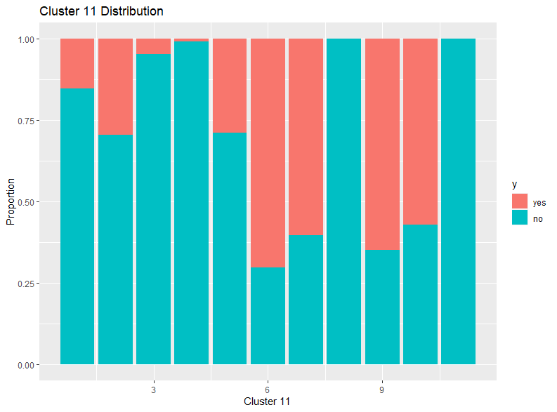
Heatmap - y Distribution
Percentage of y varies by cluster
Points to the ability of clusters to reasonably predict well

Slide 22
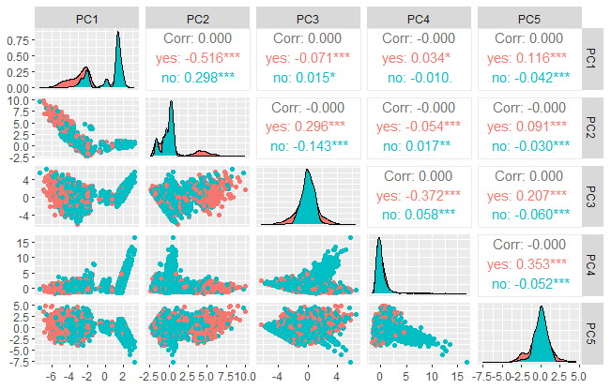
PCA Analysis
Includes only numeric variables
In order to retain at least 90% of the total variance 5 principal components were necessary to effectively represent the original data.
PC1 had the best correlation with the response variable "y”
Even PC1 doesn’t display a clear decision boundary
Notes:
PC1 has a strong negative correlation with the "yes" category (as indicated by the correlation coefficient of approximately -0.516) and a positive correlation with the "no"
category. This suggests that PC1 might be a good discriminator between the two categories and could be a valuable predictor in a logistic regression model for predicting the
probability of "yes" or "no".

Slide 23
Objective 1

Slide 24
Simple Model Creation
Forward/Backward Variable Selection
CV using 10 folds
Tried to maximize mean AUC (Area under the ROC Curve)
y ~ month + poutcome + emp.var.rate + euribor3m + contact + cons.price.idx
nr.employed removed due to high correlation
Variable | AUC
(add) nr.employed | 0.7495
(add) month | 0.7806
(add) poutcome | 0.7874
(add) emp.var.rate | 0.7885
(add) euribor3m | 0.7897
(add) contact | 0.7909
(add) cons.price.idx | 0.7924
(remove) nr.employed | 0.7929

Slide 25
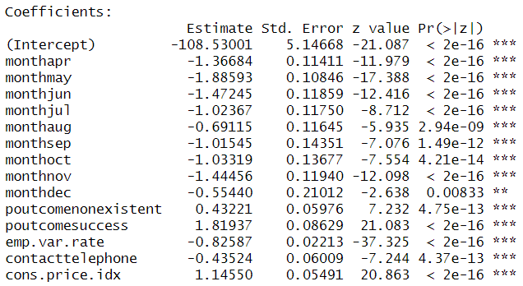
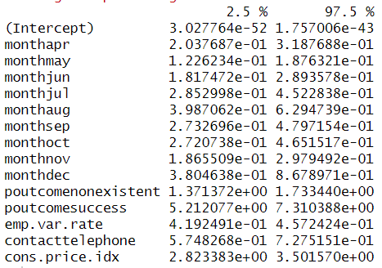
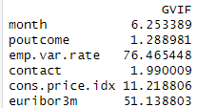
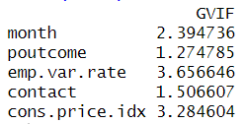
Simple Model Creation - Correlation
To reduce correlation, removed euribor3m
Correlation between emp.var.rate and euribor3m was 0.972
Mean AUC is still reasonable, 0.7918
All p values are extremely significant
All VIF values are below 5
y ~ month + poutcome + emp.var.rate + contact + cons.price.idx

Slide 26
Model Summary
Variable Name | Odds Ratio Coefficient Value | 95% Confidence Interval | P Value
monthapr | 0.2549 | (0.2038, 0.3188) | 4.60 e-33
monthmay | 0.1517 | (0.1226, 0.1876) | 1.02 e-67
monthjun | 0.2294 | (0.1817, 0.2894) | 2.14 e-35
monthjul | 0.3593 | (0.2853, 0.4523) | 2.99 e-18
monthaug | 0.5010 | (0.3987, 0.6295) | 2.94 e-09
monthsep | 0.3622 | (0.2733, 0.4797) | 1.49 e-12
monthoct | 0.3559 | (0.2721, 0.4652) | 4.21 e-14
monthnov | 0.2358 | (0.1866, 0.2979) | 1.08 e-33
monthdec | 0.5744 | (0.3805, 0.8679) | 0.0083
Poutcomenonexistent | 1.5407 | (1.3714, 1.7334) | 1.13 e-98
Poutcomesuccess | 6.1679 | (5.2121, 7.3104) | 1.33 e-71
emp.var.rate | 0.4379 | (0.4192, 0.4572) | 6.48 e-305
contacttelephone | 0.6471 | (0.5748, 0.7275) | 4.37 e-13
cons.price.idx | 3.1440 | (2.8234, 3.5016) | 1.16 e-96

Slide 27
Model Interpretation
month (Mar v Apr): The odds of convincing the clients to subscribe to a term deposit in the month of April decreases by a factor of 0.25 when compared to the month of March, all other variables remaining constant. The 95% Confidence interval of the decrease is (0.20, 0.32).
emp.var.rate: For every 1 unit increase in the employment variation rate, the odds of convincing the customer to subscribe to a term deposit decrease by a factor of 0.44, all other variables remaining constant. The 95% Confidence interval of the decrease is (0.42, 0.46).

Slide 28
Evaluation Metrics
Sensitivity, Specificity, PPV, NPV, and AUROC/AUC were calculated for each model
Since Term Deposit = ‘yes’ means more money for the bank, making sure the model predicts ‘yes’ values well is the most important
Sensitivity = Given the value is ‘yes’, model predicted ‘yes’
PPV = Given model predicted ‘yes’, value is ‘yes’
Used F1 since that is a useful way to measure positive prediction efficacy
F1 = 2 * Sensitivity * PPV / (Sensitivity + PPV)
Best value is 1

Slide 29
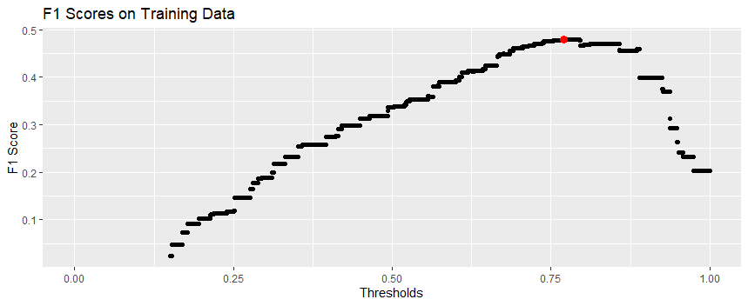
Threshold Value
0.5 is the default Threshold to use for the yes/no decision, but isn’t always the best
Got threshold value to use on Training data, but used it on Test data
Threshold to maximize F1 Score
Plot shows the F1 Scores for different Thresholds for the Simple Logistic Regression Model
Sensitivity decreases with threshold, PPV increases
Optimum threshold = 0.77
Default threshold = 0.5

Slide 30
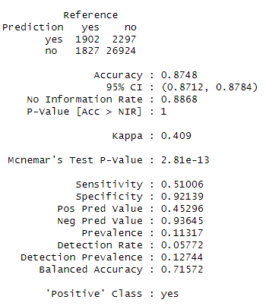
Simple Model Training Confusion Matrix
AUC for training data was 0.7868
Threshold for maximum F1 was 0.7703
Confusion matrix was obtained from this threshold
Highest F1 score was 0.4798

Slide 31
Objective 2

Slide 32
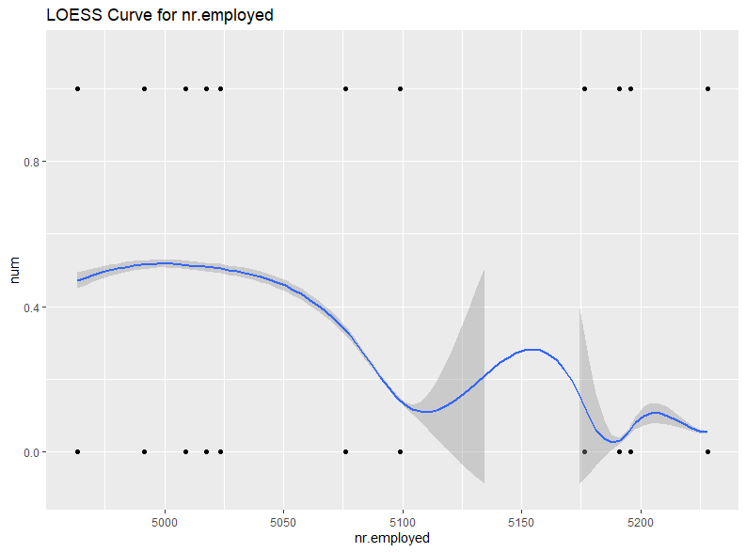
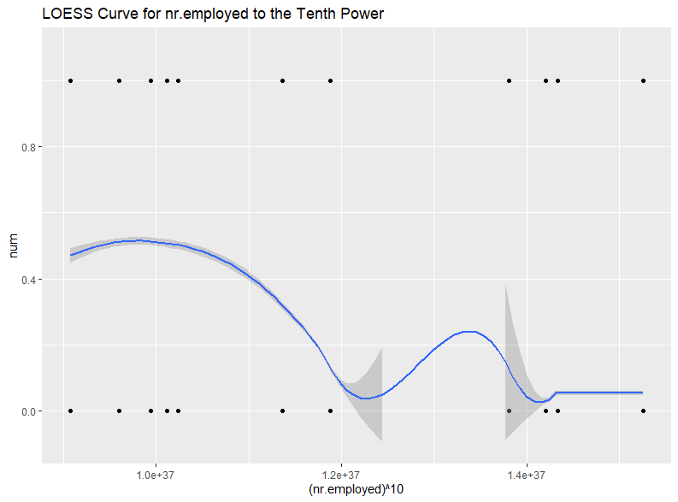
Adding Polynomial Terms to Model
Taking polynomial terms for nr.employed seems to lead to more stability when nr.employed is increased
Decided to investigate polynomials in variable selection

Slide 33
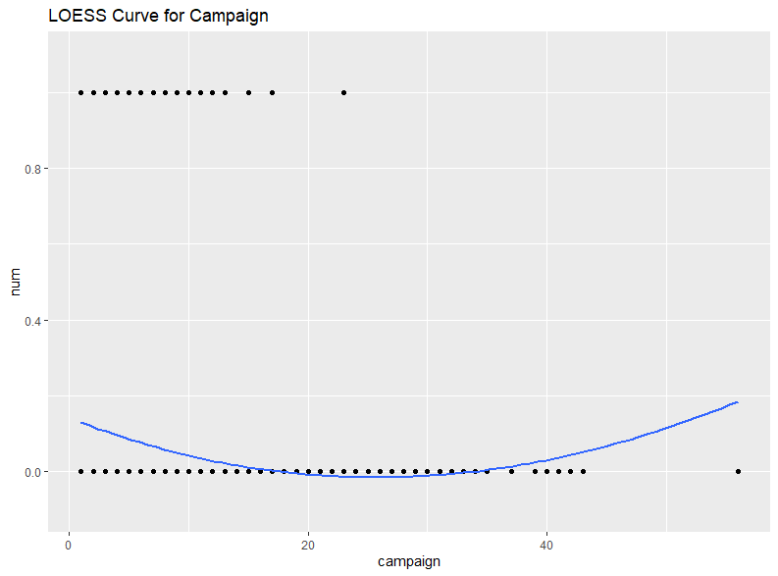
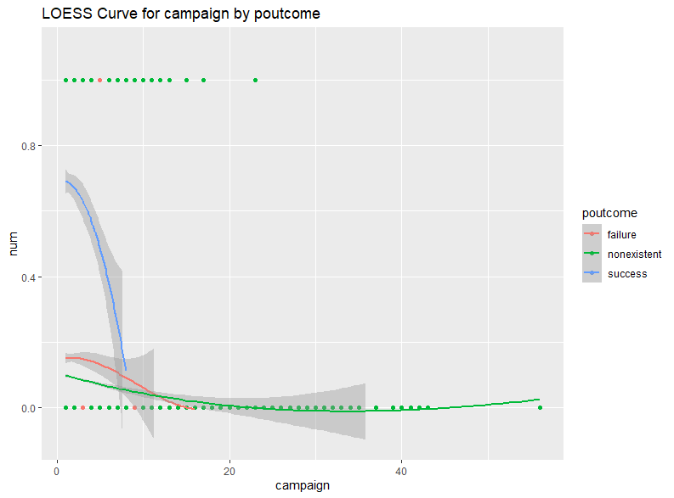
Campaign by poutcome
Campaign by itself seems that there is no constant trend
Certain poutcome values lead to a more stable behavior though
Points to a potential interaction term

Slide 34
Complex Logistic Regression Model Creation
Variable | AUC
(add) poly(nr.employed,9) | 0.7724
(add) poly(euribor3m,6) | 0.7832
(add) contact | 0.7893
(add) poutcome | 0.7949
(add) poly(cons.conf.idx,10) | 0.7965
(add) pdays | 0.7973
(add) poly(age,2) | 0.7979
… | …
(add) campaign*month | 0.8018
(remove) poutcome*campaign | 0.8023
(add) cons.conf.idx*age | 0.8024
(add) poly(previous,6) | 0.8026
(add) campaign*contact | 0.8030
(add) poly(age,3) | 0.8036
Similar approach to simple model (Forward/Backward Variable Selection, CV using 10 folds, Mean AUC as error metric)
Added single variable, polynomial variables, and interaction variables
y ~ poly(cons.conf.idx,10) + pdays + day_of_week*month + month*contact + cons.conf.idx*housing + poutcome*previous + poly(campaign,5) + poly(euribor3m,8) + campaign*month + cons.conf.idx*age + poly(previous,6) + campaign*contact + poly(age,3)

Slide 35
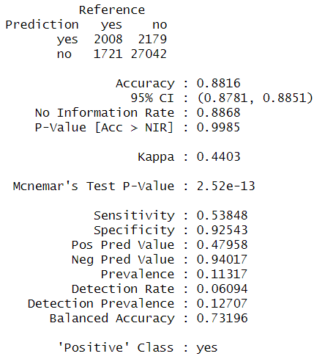
Complex Logistic Regression Confusion Matrix
AUC for training data was 0.8013
Threshold for highest F1 was 0.7354
Highest F1 score was 0.5073
All relevant metrics improved from simple logistic model

Slide 36
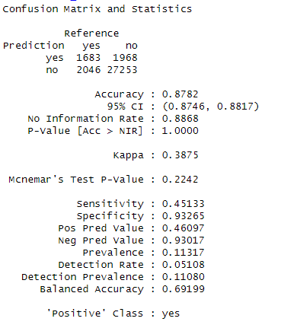
LDA/QDA Confusion Matrix
LDA model
AUC for training data was 0.7555
Threshold for highest F1 was 0.2306
Highest F1 score was 0.4561
Used only numeric variables–y ~ emp.var.rate + cons.price.idx + euribor3m

Slide 37
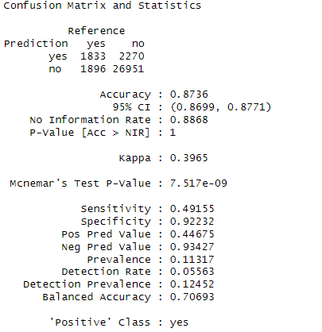
LDA/QDA Confusion Matrix
QDA model
AUC for training data was 0.7694
Threshold for highest F1 was 0.1264
Highest F1 score was 0.4681
Used only numeric variables–y ~ emp.var.rate + cons.price.idx + euribor3m

Slide 38
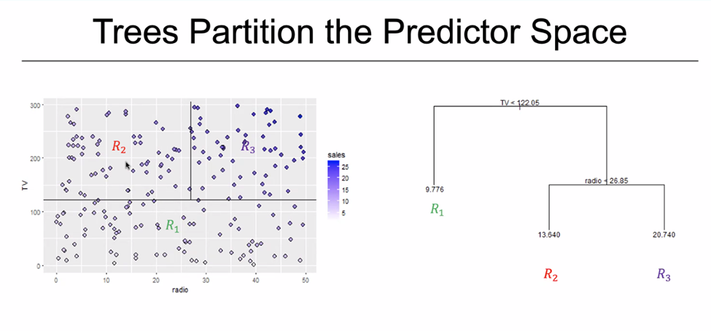
Random Forest Introduction
Decision Trees split up Explanatory Variables into partitions
Random Forest is a collection of Decision Trees
Non-parametric Model
Hyper-parameters
Mtry = 2
Amount of variables randomly selected each split
Ntree = 6000
Amt of decision trees in the model
Random Forests are generated differently each time

Slide 39
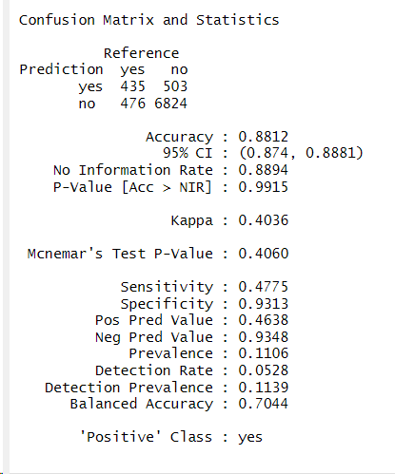
Random Forest: Confusion Matrix
Tested 2 packages: Caret and randomForest, went along with the randomForest because the AUC was better by ~5%.
We used the simple Logistic model equation: y ~ month + poutcome + emp.var.rate + contact + cons.price.idx
AUC for training data was 0.7044
Threshold for highest F1 is 0
Overfitting due to the high complexity of the RF model
Models only output probabilities of 0 and 1
Seems to be the case for both packages
Highest F1 score was 0.4569
Notes:
Overfitting due to the high complexity of the RF model relative to the training data

Slide 40
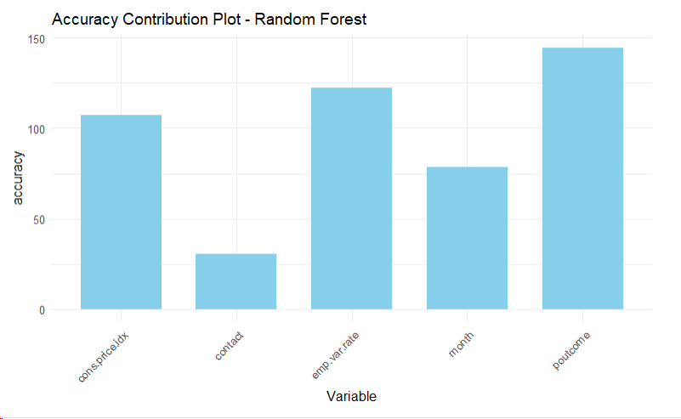
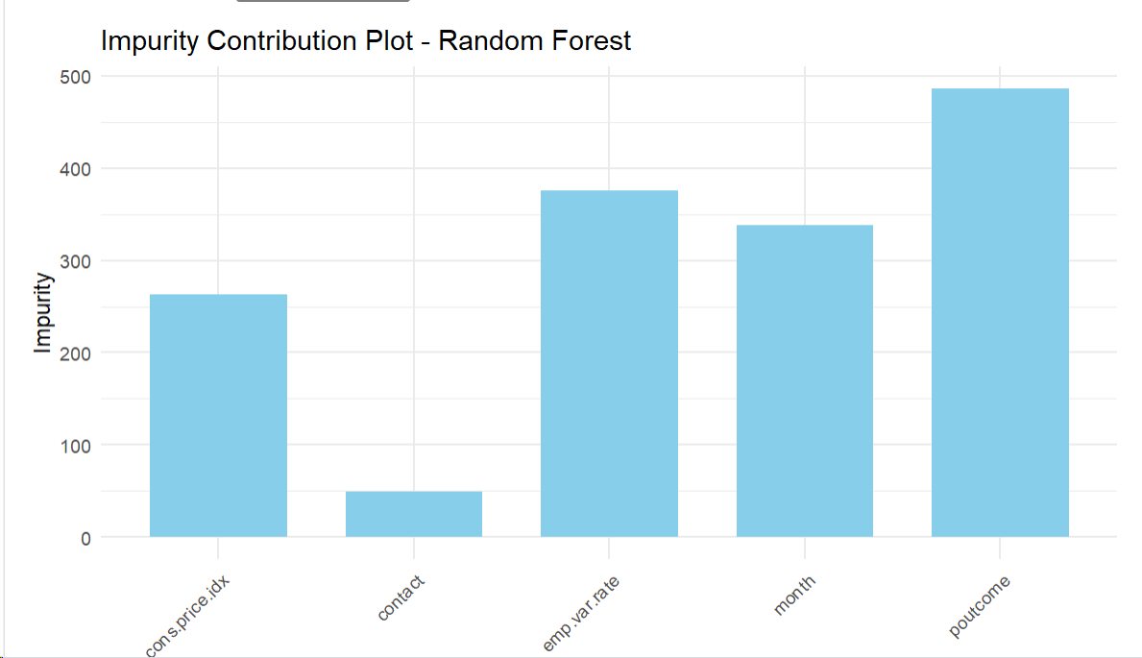
Random Forest: Contribution Plots
The 3 most impactful variables based on the overall accuracy to the models are Poutcome, emp.var.rate, cons.price.idx.
The 3 variables that reduces model impurity (i.e. randomness) the most are also Poutcome, emp.var.rate, cons.price.idx

Slide 41
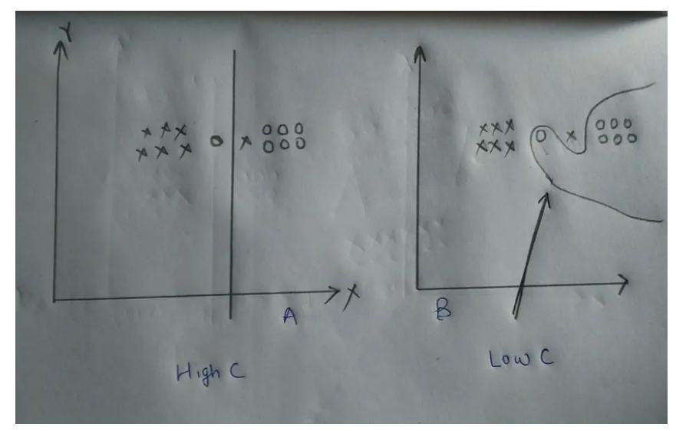
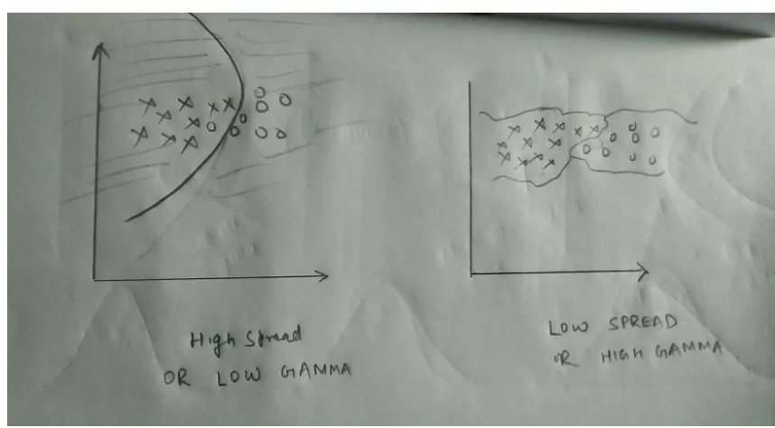
Support Vector Machines (SVM)
Non-parametric model for both regression and classification
Creates a boundary (line, plane, or hyper-plan) of best fit to classify the data points
Hyper-parameters for model creation:
Kernel = type of curve (line, polynomial, radial, etc.)
Gamma = affects the fluctuations in the boundary
Cost = affects the bias / variance trade-off
Pictures from: https://medium.com/@myselfaman12345/c-and-gamma-in-svm-e6cee48626be

Slide 42
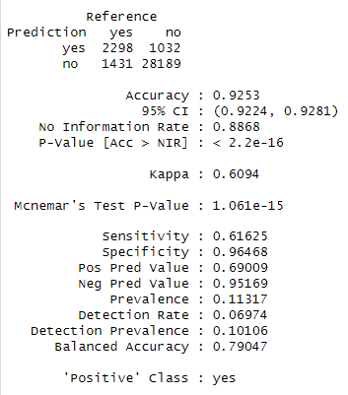
SVM Training Confusion Matrix
We used y ~ euribor3m + month + poutcome + contact + cons.conf.idx + campaign + previous + age + housing + day_of_week
All the variables from the complex model, just none of the complexity
Cost = 10 (less variance)
Gamma = 1 (more fluctuations)
Thresholds were very low (0.08-0.10)
F1 = 0.65, AUC = 0.8513, highest values we’ve seen on the training data
Sensitivity = 0.6163, PPV = 0.6901
Usually Sensitivity > PPV
Notes:
The metrics where the highest weve seen on the training data
Our sensitivity of 0.6163 is smaller than the PPV of 0.6901, which is strange, because usually across our previous models like the SLM and CLM, and RF the Sensitivity > PPV

Slide 43
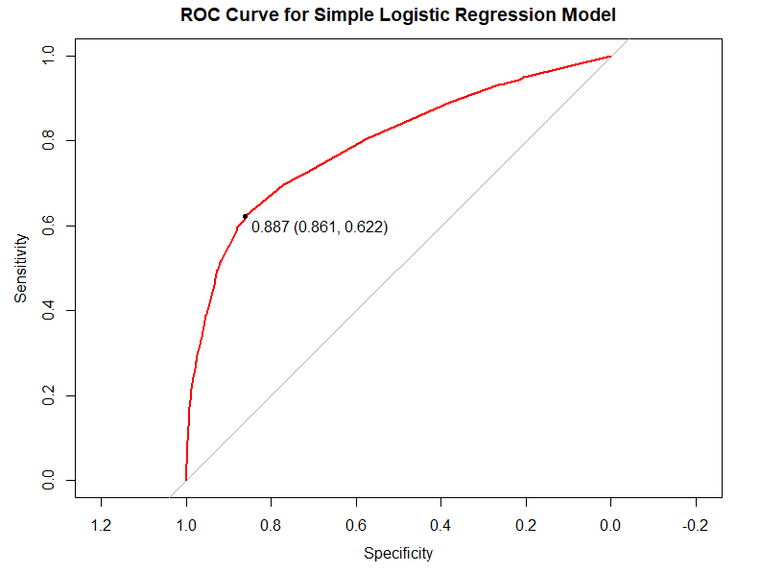
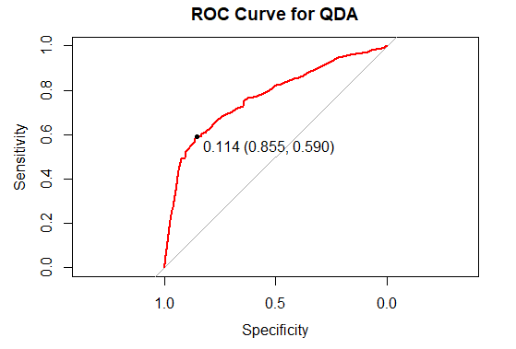
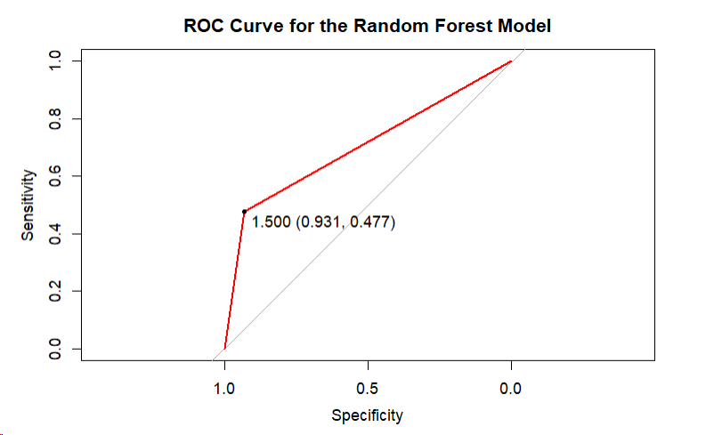
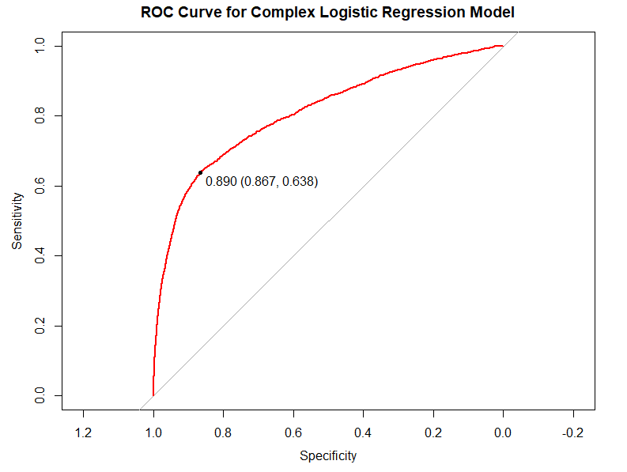
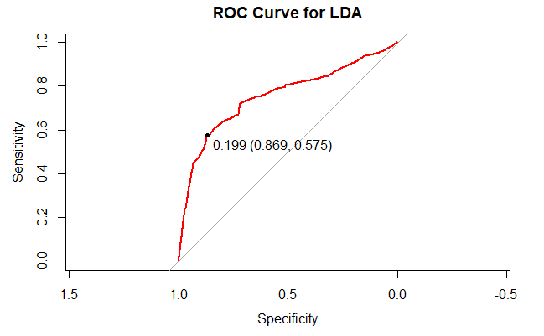
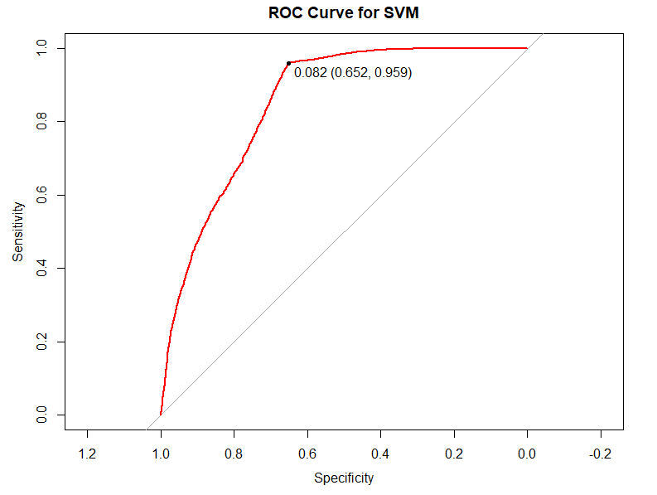
ROC Curves

Slide 44
Model Validations
Model | Sensitivity | Specificity | Prevalence | PPV | NPV | F1 | AUROC
Simple Logistic Regression | 0.4929 | 0.9221 | 0.1106 | 0.4402 | 0.9360 | 0.4650 | 0.7868
Complex Logistic Regression | 0.5280 | 0.9249 | 0.1106 | 0.4665 | 0.9403 | 0.4954 | 0.8013
LDA Model | 0.4522 | 0.9335 | 0.1106 | 0.4583 | 0.9320 | 0.4552 | 0.7506
QDA Model | 0.4829 | 0.9255 | 0.1106 | 0.4463 | 0.9351 | 0.4639 | 0.7623
Random Forest Model | 0.4775 | 0.9313 | 0.1106 | 0.4638 | 0.9348 | 0.4705 | 0.7044
Support Vector Machine (SVM) | 0.5236 | 0.8705 | 0.1106 | 0.3345 | 0.9363 | 0.4082 | 0.6979
Notes:
We can see that across our metric, our complex

Slide 45
Conclusions

Slide 46
Model Comparisons
Complex Logistic Regression had the highest Sensitivity, PPV, F1 score, and AUROC
Logistic models easier to work with
LDA model had lowest Sensitivity but highest Specificity
Random Forest worse Sensitivity than Simple Logistic Model
SVM had the worst PPV, F1, and worst drop off between training and test results (overfit)
Non-parametric models took the longest to train
No models really did “well”, all had PPV < 50%
Sensitivity was always much less than Specificity, due to the high No count

Slide 47
Model Validations on future data
Tried training on older data and testing on newer data
Originally did a random 80/20 split of the data
Training F1 was worse (~0.25, about 50% worse than previously)
Needed to filter test data and simplify complex model due to missing values that were present in training
Testing Sensitivity, PPV, and F1 was better, but Specificity, NPV, and AUROC was worse
Simple model performed better than complex model
Model | Sensitivity | Specificity | Prevalence | PPV | NPV | F1 | AUROC
Simple Logistic Regression | 0.4929 | 0.9221 | 0.1106 | 0.4402 | 0.9360 | 0.4650 | 0.7868
Simple Logistic Regression (Future) | 0.5661 | 0.7740 | 0.2979 | 0.5151 | 0.8079 | 0.5394 | 0.7095
Complex Logistic Regression | 0.5280 | 0.9249 | 0.1106 | 0.4665 | 0.9403 | 0.4954 | 0.8013
Complex Logistic Regression (Future) | 0.6287 | 0.6716 | 0.2979 | 0.4482 | 0.8100 | 0.5233 | 0.6502

Slide 48

Tips for next Campaign
March is the best month to call in, but August and December aren’t bad either
Call people if they subscribed to a Term Deposit previously
Call more when socio-economic indicators are low
Notes:
Based on our analysis, We highly suggest For the next campaign, that the campaign team focus on the month of march, also look into the months of August and December.
PPl are more likely to say yes if the previously subscribed the previous time,
It'll more beneficial to call more when socio economic variables are low

Slide 49
Future Work
Interpretive analysis with Duration variable
Oversampling the Yes data to improve Sensitivity
Variable Selection tailored for the Random Forest Model
Re-visit SVM to reduce out of sample error
Ensemble model

Slide 50
Thank you!
Aaron Abromowtiz: aabromowitz@mail.smu.edu
Stephanie Duarte: duartes@mail.smu.edu
Dammy Owolabi: oowolabi@smu.edu
Notes:
Thank you for your time, heres out linkedin if you will like to connect to ask more questions or reach out. We appreciate the time you took to listen tp our presentation. Have a wonderful day.

Slide 51
Backup

Slide 52
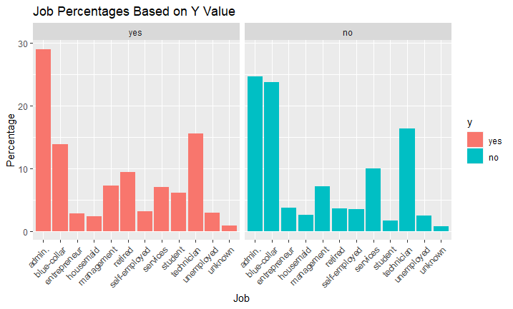
Job Data
Bank client data
Categorical
There are jobs where the amount of yes vs no changes drastically
Ex: admin, blue-collar, retired, services, student
Overall, not clear if this will be a good variable for prediction

Slide 53
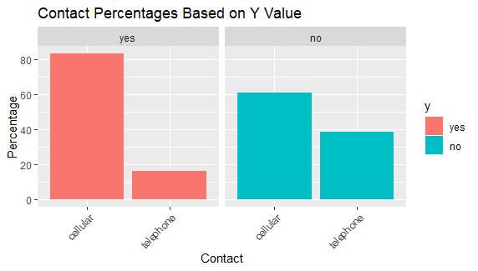
Contact Data
Related with the last contact of the current campaign
Categorical
Last contact approach
Contact over cell phone was ~20% more likely to lead to a term deposit

Slide 54
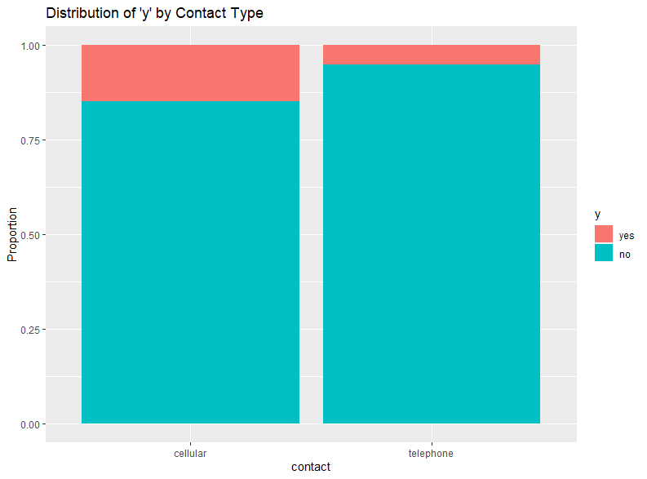
Contact Data
Related with the last contact of the current campaign
Categorical
Last contact approach
Contact over cell phone was ~20% more likely to lead to a term deposit

Slide 55
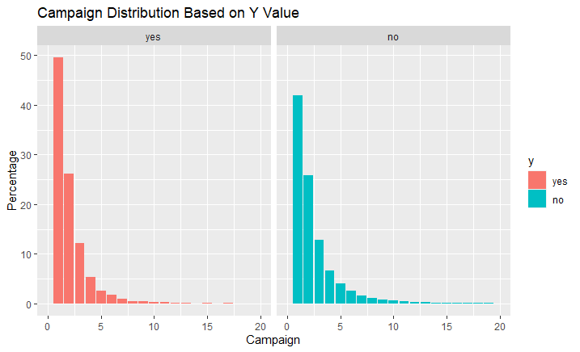
Campaign Data
Number of contacts performed during this campaign and for this client
Categorical
Both have similar, exponential decay distributions

Slide 56
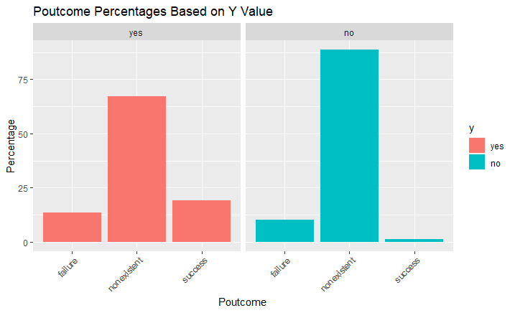
Poutcome Data
Outcome of the previous marketing campaign
Categorical
Success is more common for clients with a Term Deposit

Slide 57
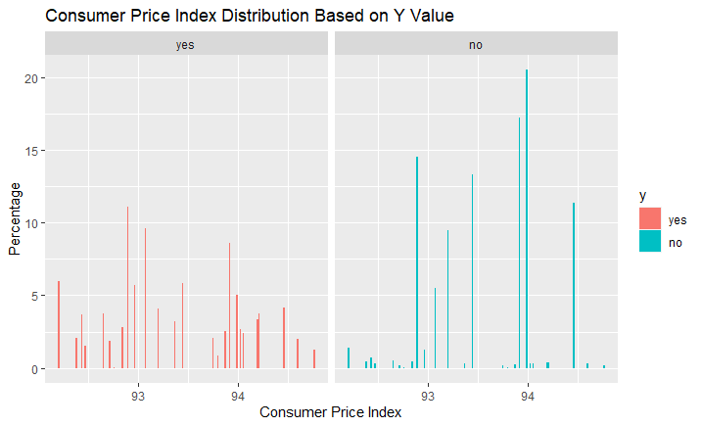
Consumer Price Index
Socio Economic Data
Numeric
Monthly Indicator
The value seems more evenly distributed for people that have a term deposit

Slide 58
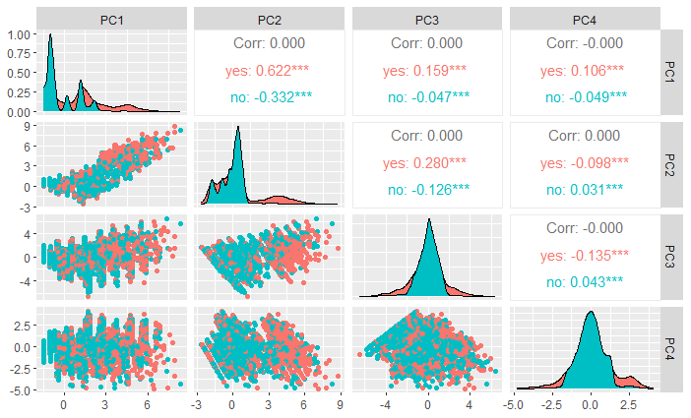
PCA Analysis
Removed numeric variables- age, campaign, and cons.conf.idx
In order to retain at least 90% of the total variance 4 principal components were necessary to effectively represent the original data.
PC1 had the best correlation with the response variable "y”
Notes:
age, campaign, and cons.conf.idx had the lowest correlation to PC1
C1: It shows the strongest correlation with the response "yes" (approximately 0.622) and is negatively correlated with "no" (approximately -0.332). The asterisks indicate that this correlation is statistically significant.
The plot suggests that among the components shown, PC1 would be the best predictor for the outcome "yes" when considering building a logistic regression model.
Pdays, previous,emp.var.rate, cons.price.idx, cons.conf.idx were the highest variables correlated.

Slide 59
Model Interpretation
month (Mar v Apr): The odds of convincing the clients to subscribe to a term deposit in the month of April decreases by a factor of 0.25 when compared to the month of March, all other variables remaining constant. The 95% Confidence interval of the decrease is (0.20, 0.32).
poutcome (success v failure): The odds of convincing a client to subscribe to a term deposit who was successfully subscribed in the previous campaign is 6.17 times higher than that of someone who was not successfully subscribed, all other variables remaining constant. The 95% Confidence interval of the factor is (5.21, 7.31).
contact (cellular v telephone): The odds of convincing the client to subscribe to a term deposit when calling their landline phone decreased by a factor of 0.65 when compared to calling their cell phone, all other variables remaining constant. The 95% Confidence interval of the decrease is (0.57, 0.73).
emp.var.rate: For every 1 unit increase in the employment variation rate, the odds of convincing the customer to subscribe to a term deposit decrease by a factor of 0.44, all other variables remaining constant. The 95% Confidence interval of the decrease is (0.42, 0.46).
cons.price.idx: For every 1 unit increase in Consumer Price Index, the odds of convincing the customer to subscribe to a term deposit increase by 214%, all other variables remaining constant. The 95% Confidence of the increase is (182%, 250%).

Slide 60


Adding Polynomial Terms to Model
Adding Polynomial terms to Model seemed to improve AUC
This was observed for out of sample metrics
Improvement seems to happen after 3 polynomial terms
P values remaining significant
Decided to investigate polynomials in variable selection
Max Polynomial = 9

Slide 61

Adding Interaction Terms to Model
Some variable interactions showed different distributions of Term Deposits depending on the combination
Ex: Tue/Mar has more yes than Tue/May
Ex: Thu/Apr has more yes than Mon/Apr
Decided to try interactions in variable selection

